Slide 1


AI-Driven Citizen Support and Complaint Management Using Natural Language Processing Course code – DSA0306 Natural Language Processing
Presented by: T. Kiran Kumar(192472321) Y. Sai kumar (192425218)
Leela Sravan kumar (192425272)
A Mohith Krishna (192425199)
K Varshan (192325089)
Guided by – T. Kumaragurubaran

Slide 2
Introduction
Government agencies receive thousands of citizen complaints every day through websites, mobile apps, emails, and social media.
Manual complaint handling is slow, time-consuming, and prone to delays and errors.
Artificial Intelligence (AI) combined with Natural Language Processing (NLP) enables computers to understand, analyze, and process human language.
The proposed system automatically understands citizen complaints, categorizes them, identifies urgency, routes them to the appropriate department, and provides instant responses.
This improves transparency, efficiency, citizen satisfaction, and overall public service delivery.

Slide 3
Objectives
To Develop an AI-based citizen complaint management system using NLP.
To Automatically classify complaints into relevant government departments.
To Detect complaint priority and urgency using sentiment and text analysis.
To Identify duplicate or similar complaints to reduce redundant processing.
To Provide multilingual support for citizens.
To Generate automated acknowledgments and responses using AI.
To Track complaint status and provide real-time updates.
To Improve complaint resolution efficiency, transparency, and citizen satisfaction.

Slide 4


Existing System
Citizens submit complaints through websites, mobile apps, phone calls, or help desks.
Complaints are generally stored and processed manually.
Complaint category and department are often selected manually.
Text-based complaints are mainly handled as simple text records.
Images or videos are generally used only as supporting evidence.
Duplicate complaints may be registered as separate cases.
Priority is often assigned based on manual assessment.
Limited AI-based analysis and city-level intelligence is available.
This can result in delays, repeated work, and inefficient resource allocation.

Slide 5
Problem Statement
Existing complaint management systems rely heavily on manual processing.
Complaints submitted in different languages and writing styles are difficult to analyze quickly.
Delays in complaint classification and forwarding increase resolution time.
Duplicate complaints waste administrative resources.
Lack of real-time status updates reduces citizen trust.
There is a need for an intelligent system that can automatically understand, classify, prioritize, and manage citizen complaints using NLP techniques.

Slide 6
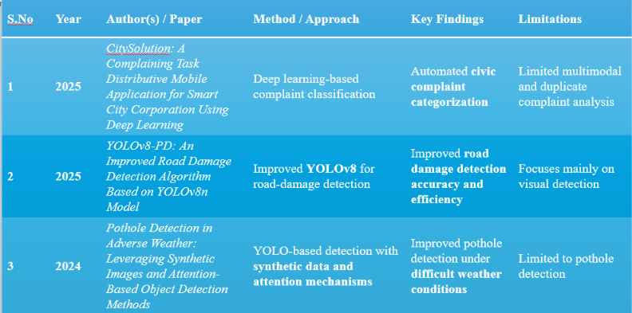
Literature Survey

Slide 7
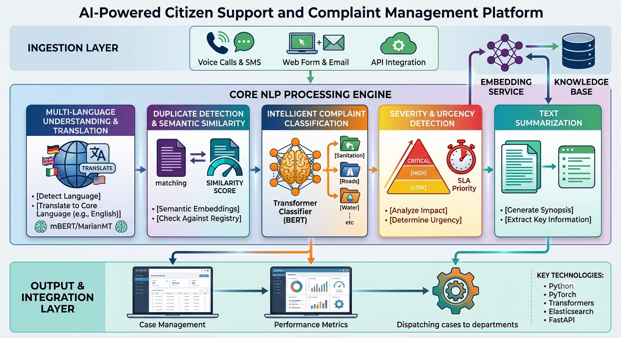
Architecture Diagram

Slide 8
Module 1 : Multi-language Complaint Understanding and Translation
Novelty: Allows citizens to submit complaints in regional languages and automatically translates them into a common language while preserving the original meaning using mBERT and NMT.
Working:
The citizen submits a complaint in any supported language.
The translation model detects the language.
The complaint is translated into English (or another common language).
The translated complaint is processed by the system.
Uses:
Machine translation.
Language identification.
Supports multilingual communication.

Slide 9
Module 2: Intelligent Complaint Classification using Transformer Models
Novelty: Automatically categorizes complaints into departments (Water, Electricity, Roads, Sanitation, etc.) using advanced NLP model BERT.
Working:
The citizen enters a complaint.
The BERT model analyzes the text and understands its context.
The complaint is automatically classified into the correct department (Water, Roads, Electricity, Sanitation, etc.).
The complaint is forwarded to the respective department.
Uses:
Text classification.
Improves routing accuracy.
Reduces manual effort.

Slide 10
Module 3: Complaint Severity and Urgency Detection
Novelty: Automatically identifies the urgency of a complaint by analyzing its sentiment and emotional tone, ensuring critical issues are handled first.
Working:
The citizen submits a complaint.
The sentiment analysis model evaluates the text.
The system assigns a priority level (Low, Medium, High, or Critical).
High-priority complaints are forwarded for immediate attention.
Uses:
Sentiment analysis.
Priority prediction.
Faster emergency response.

Slide 11
Module 4: Duplicate Complaint Detection using Semantic Similarity
Novelty: Detects duplicate complaints by comparing the meaning of new complaints with existing ones instead of matching only exact words.
Working:
A new complaint is submitted.
The semantic similarity model compares it with previous complaints.
If the similarity score is high, the complaint is marked as a duplicate.
Otherwise, it is registered as a new complaint.
Uses:
Semantic similarity.
Duplicate complaint detection.
Reduces redundant records.

Slide 12
Module 5: Smart City Intelligence & Analytics
Purpose: Convert complaint data into useful information for municipal authorities.
Analyzes complaints based on location, time, category, and status.
Identifies frequently occurring civic problems.
Detects complaint hotspots.
Shows department-wise complaint statistics.
Tracks unresolved and recurring complaints.
Helps authorities understand city-level problem patterns.
Supports better resource allocation and decision-making..

Slide 13
Conclusion
The proposed system uses Artificial Intelligence and Natural Language Processing to make citizen complaint management faster and more efficient.
It can understand, classify, translate, and process complaints submitted in natural language.
Automated complaint categorization and routing can reduce manual effort and response delays.
Multilingual support improves accessibility and inclusiveness for citizens from different linguistic backgrounds.
Complaint analysis can help authorities identify common problems and service gaps.
Overall, the system provides a smart, scalable, and citizen-friendly approach to modern complaint management.
With further development, AI-based citizen support can contribute to faster resolution, improved transparency, and better public services.

Slide 14
Future Scope
AI-Powered Classification: Improve automatic categorization and prioritization of complaints using advanced NLP and machine learning.
Sentiment Analysis: Detect urgency, frustration, and public sentiment to prioritize critical complaints.
Smart Routing: Automatically forward complaints to the appropriate department or authority.
Real-Time Monitoring: Provide dashboards for tracking complaint status, response time, and resolution rates.
Predictive Analytics: Identify recurring issues and predict potential problems before they become major complaints.
Chatbot Integration: Provide 24/7 AI-based assistance for complaint registration, status tracking, and FAQs.
Mobile and Web Integration: Develop accessible platforms for citizens to interact with government services easily.

Slide 15
THANK YOU

